Slide 1
STUDYING PERFORMANCE OF LTE NETWORKS WITH QUEUING SYSTEMS
Prem Sujan(170123027)
&
Garvit Mehta(170123018)
Project Guide: Prof. N. Selvaraju

Slide 2
Objective
The main aim of the project is to study various Queuing Models in the context of LTE Networks and establish various performance metrics for LTE Networks. We will study NBurst/M/1 queuing model which has a close resemblance to practical LTE networks. First, we establish the results of M/M/1 model for the LTE network and further we simulate the actual network traffic using NBurst/M/1 model to confirm them.

Slide 3
Background of the problem
Long Term Evolution (LTE) started as a project in 2004 by Third Generation Partnership Project (3GPP) to provide technology focusing on packet-switched data.
This explosive growth of mobile data traffic and adoption of mobile connectivity by end users is increasing of global 4G LTE deployments and adoption.

Slide 4
Importance of the problem
While end users and application developers are expecting the networks to handle the high traffic rate, the heterogeneous nature of the traffic poses a challenge to understand the performance of the network.
So performance analysis of the network is crucial to improvements of the network.

Slide 5
Previous studies in the area
Analysis of the real LTE network systems
LTE network simulation using M/M/1 queuing model
LTE network simulation using M/M/c queuing model

Slide 6
Queuing systems
Queuing systems deal with the mathematical study of congestion.
Generally, the study of servicing requests from customers/entities arriving in a queue fashion at a facility is called queuing theory.
Examples: Ticket booking, customer service centers.

Slide 7
Some mathematical terms
Markov Property Poisson Process Arrival rate Service rate Little’s Law Kendall notation Traffic rate,L_{s},L_{q},W_{s},W_{q}

Slide 8
Markov Property
A stochastic process has the Markov property if the conditional probability distribution of future states of the process (conditional on both past and present states) depends only upon the present state, not on the sequence of events that preceded it.
P(G > a + b|G > a) = P(G > b)
Exponential random variable follows markov property.
Also referred to as memoryless property.

Slide 9

Poisson process
The counting process N(t), t∈ [0,∞) is called a Poisson process with rate λ if it follows the condition
N(0)=0
N(t) has independent increments
The number of arrivals in any interval of length τ>0 has Poisson(λτ) distribution.

Slide 10
Arrival rate
Service rate
The rate at which customers/entities arrive at service stations with a request.
Units: (T)⁻¹
The rate at which servers fulfill the requests produced by the customers.
Units: (T)⁻¹

Slide 11
Little’s Law
The fundamental relationship between the three parameters λ(arrival rate), L(length of the system), W(waiting time in the system)
L = λW
This follows from the Law of large numbers.

Slide 12
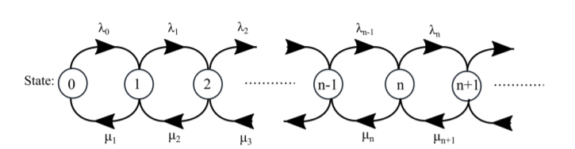
Birth death process
Birth death process is a variation of Markov process with discrete space where the system can transitions only to its neighbouring states as shown in the figure.
Transition to a lower state is referred to as death, and transition to a higher state is referred to as a birth.

Slide 13
Queuing models
Queuing models are mainly characterised by the process of arrival, the service mechanism, and queuing discipline.
Arrivals can be batch, continuous, poisson distributed, etc.
Queuing discipline can be FCFS, LCFS, Priority queuing, etc.
Different combination of these produce different analytical models.
We use a notation to describe queuing models

Slide 14
Kendall’s notation
Kendall notation is a standard system used in queuing
systems to describe a queuing model with three factors A/S/c. Sometimes
also referred to as A/S/c/K/N/D.
A: Arrival process.
S: Servicing process.
c: Number of service channels.
K: Length of the queue.
N: Customer population
D: Service discipline

Slide 15
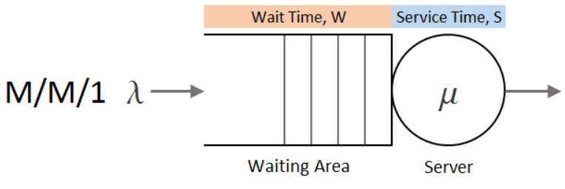
M/M/1 queue
A simple single server queue system with interarrival time and service time following exponential distributions is called M/M/1 queue.
This is a special case of birth-death process with state independent transition rates.

Slide 16
Steady state probabilities
The probability of the system to stay in state n at time t is denoted by P_{n}(t)
From the birth-death process state diagram we can see that at time t+h (very small h), to stay in the same state n, there are 3 cases as follows
From state n-1 with one request and no service
From state n+1 with no request and one service
Remain in state n with no request and no service
From poisson distribution we have P(N(h)=1) = λh

Slide 17
The 3 cases when written mathematically,
P_{n}(t + h) = P_{n−1}(t)λh(1 − µh) + P_{n+1}(t)(1 − λh)µh + P_{n}(t)(1 − λh)(1 − µh) for n>0
(λ + µ)P_{n} = P_{n+1}µ + P_{n−1}λ (1)
P₀(t + h) = P₁(t)(1 − λh)µh + P₀(t)(1 − λh)
λP₀ = µP₁ (2)
From (1) and (2) we have
P_{n} = (λ/µ)^{n}P₀

Slide 18
Steady state probabilities
P_{n} = ρ^{n}P₀
An important parameter of the queueing system is traffic rate ρ = λ/µ
Sum of steady state probabilities is
P₀ + P₁ + P₂ ... P∞ = 1
P₀ = 1 − ρ
P_{n} = (1 − ρ)ρ^{n}
We can see that the λ/µ < 1 for a positive steady probability for state n

Slide 19
Performance metrics(L_{s},L_{q},W_{s},W_{q})
The quality of the service as seen from the customer perspective can be determined by the following metrics
L_{s} is the average number of customers in the system
L_{q} is the average number of customers in the queue
W_{s} is the average time spent by a customer in the system
W_{q} is the average time spent by a customer in the queue

Slide 20
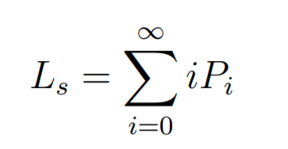
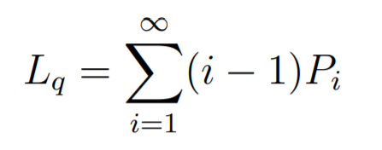
Performance metrics (contd.)
L_{s}=(ρ/1-ρ)
L_{q}=(ρ²/1-ρ)

Slide 21
Performance metrics (contd.)
From Little’s law,
W_{s}= L_{s}/λ= (1/µ-λ)
W_{q}= L_{q}/λ= (λ/µ(µ-λ))
It can be observed that
L_{q} = L_{s}ρ W_{q} = W_{s}ρ

Slide 22
Why M/M/1 model fails for LTE systems
LTE system traffic originates from several terminal devices which request and upload data independently.
And the traffic generated by each device is further dependent on the application type used.
So we need a novel queue model to study LTE systems.

Slide 23
N-Burst Model for LTE Networks

Slide 24
Need For a New Model
There is an incredible growth in the number of wireless devices such as smart-phones, tablets and Internet of Thing (IoT) .
In addition to the fast development of media streaming applications, IPTV, telemedicine and Internet gaming have led to a significant challenge to the design and deployment of cellular technology.
Investigating and analyzing the distribution of data generated by each device in LTE network should be the most important factor to estimate the quality requirements and capabilities of LTE networks.

Slide 25
Required Properties for an appropriate model
The main difference from the standard models is the requests in telecommunication networks come in bursts rather than continuously.
The unpredictable traffic must be both bursty and self-similar.
Many models like M/G/1 queue with changing parameters, batch-arrival model, continuous burst flow models failed to mimic the traffic in telecommunication networks.

Slide 26
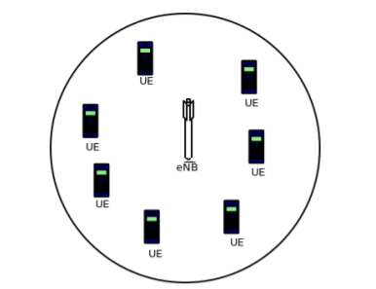
LTE Network Topology
A simple LTE network consists of a evolved nodeB, which provides service to a set of N wireless devices.
These devices use the LTE technology for downloading data (down-link) and upload and request data (up-link).

Slide 27
Describing Network Queue
The number of packets requested by a mobile device is considered as a random variable.
The properties and distribution of this random variable is purely based on the mobile application used to request the data.
This is the reason standard queuing models are not appropriate to understand telecommunication systems.

Slide 28
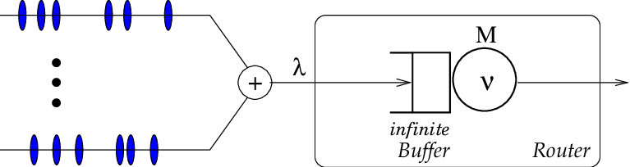
The packet generated by each user arrive at a single queue which is maintained by a Router.

Slide 29
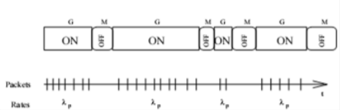
Description of Model
N Burst Model is one of the variants of ON-OFF models
The arrival process of N-Burst is the superposition of N ON-OFF type identical and independently distributed source's traffic streams.

Slide 30
Essential parameters of Model
𝜿 : average rate of packet arrival for each source.
λ: The overall arrival rate that is produced by N sources i.e. λ = 𝜿 N
λ_{p}: the peak transmission rate during a burst i.e. at ON time.
λ_{b}: Mean burst arrival rate =λ/N_{b}.
N_{b}: Average number of packets during a burst (at ON period)
ON : the average time during which the node is active
OFF : the average time during which the node transmission is OFF.

Slide 31
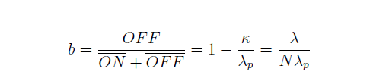
Essential Parameters of the Model (contd...)
μ : the mean service rate of the router
ρ = λ/μ : Load utilisation of the router
The Burstiness Parameter b is defined below
Since λ(the amount of data sent per unit time), and ρ can be held constant as b is varied over 0 to 1. So the parameter b can be considered as a shape parameter.

Slide 32
Two Simple Cases for b
Case 1 : b=0
When b=0, it means that average time during which the node transmission is OFF is 0.
In this case all the bursts come after one another and ON/OFF process reduces to a simple one.
Case 2 : b=1
In this case, the average time during which burst comes is zero.
It also means that all the packets in the burst arrive simultaneously i.e. They arrive as a bulk process.

Slide 33
Distribution of Sub-Processes
Considering the 1-Burst Model i.e. N=1. This model depends on four separate distributions , with random variables denoted by X_{ON}, X_{OFF} , X_{SV} and X_{INP} .
ON: On time distribution have mean ON. Therefore the mean number of packets during a burst is given by N_{b} = ON.λ_{p}
OFF: OFF time distribution have mean OFF (It will depend on how often the bursts are generated)
SV: Service time distribution has mean 1/μ . ( It will depend on distribution of packet sizes, service rate depends on packet size and router speed)
INP: Inter packet time distribution is the distribution during a burst whose mean is 1/λ_{p}

Slide 34
Limiting Case Analysis for b->0
We can conclude that the the transmission of packets can occur at the slowest rate at ON times when OFF = 0 or b=0 (λ_{p} = 𝜿).
In this case the distribution of OFF time is irrelevant.
ON distribution also does not have an impact on the system.
Thus for b -> 0 the 1-Burst process reduces from SM/G_{SV}/1 queue to a G_{INP}/G_{SV}/1 queue. (X_{OFF} ,X_{INP} and X_{ON} are the distributions on which SM depends where SM denotes Semi Markov)

Slide 35
Limiting Case Analysis for b->1
If we increase λ_{p} indefinitely we get b -> 1 i.e. ON -> 0
It also means that all the packets in a given burst arrive simultaneously
Also called BULK ARRIVAL.
The bulk size is distributed according to ON-time distribution whose mean is N_{b}.
The time in between two bursts is distributed according to X_{OFF}.
1-Burst process reduces to a G_{(OFF)}^{[ON]}/G_{SV}/1 queue where G_{(OFF)}^{[ON]} represents the bulk arrival process whose Inter Arrival times are X_{OFF} and bulk sizes proportional to X_{ON}.

Slide 36
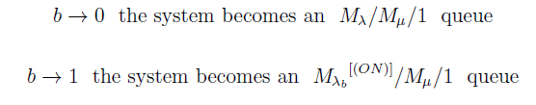
Concluding Remarks
Our base model should be simple, so we take X_{OFF} , X_{SV} and X_{INP} as exponential distributions. The ON distribution will be varied to obtain different results. Our model have parameters from each of these models.

Slide 37

Delay Calculation For b=0
Although, the analytic N-Burst model can be evaluated for all possible distributions,the calculations are not trivial.
So we give mean packet delay for b=0
mdb0 represents mean packet delay for b=0.

Slide 38
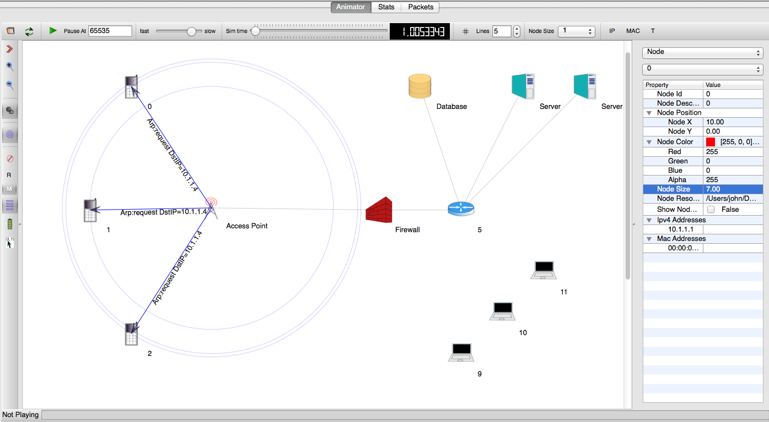

NS-3 simulator
NS-3 is a discrete-event network simulator, targeted primarily for research and educational use.
NS3 is used to simulate modern network systems with real time scheduler.

Slide 39
Future work
Simulating M/M/1 model for LTE networks on NS3 with varying parameters to analyse packet loss, delay, throughput to confirm if they follow the model characteristics.
Define LTE network topology and simulate a more appropriate model, NBurst/M/1 on NS3 with varying ON time distribution to analyse the performance of the network system.

Slide 40
Thank You

